Slide 1
TERMS AND CONDITIONS
These PowerPoint slides are a tool for lecturers, and as such:
YOU MAY add content to the slides, delete content from the slides, print out the slides, and save the slides onto your computer or server.
YOU MAY NOT resell, reproduce or redistribute the content in any form whatsoever, without prior written permission from the copyright holder.
© Troupant Publishers (Pty) Ltd, 2016
Selected images used under licence from Shutterstock.com

Slide 2
Engineering Systems
NQF Level 2

Slide 3
Preparing and setting up engineering systems for operation
Module 8

Slide 4
Preparing and setting up an air compressor
Unit 8.1

Slide 5
An air compressor
Figure 8.1 An air compressor

Slide 6
Applications of an air compressor
Air compressors are used to:
Supply high-pressure clean air to fill gas cylinders.
Supply a large amount of moderate-pressure air to power pneumatic tools.
Fill tyres.

Slide 7
Risks involved in using an air compressor
Explosion or fire.
Bursting.
Flying objects.
Electrical shock.
Burns.
Moving parts.
Unsafe operation.

Slide 8
Air compressor maintenance schedule
Drain water from the air tank and any moisture separators.
Check for any unusual noise and/or vibration.
Manually check all safety valves to make sure they are operating properly.
Inspect the air filter and replace if necessary.
Check the fluid level.

Slide 9
Air compressor maintenance schedule
Check the power connections.
Check and rectify any oil and air leaks.
Inspect air lines and pipe fittings for leaks and correct if necessary.
Check all the belts.

Slide 10
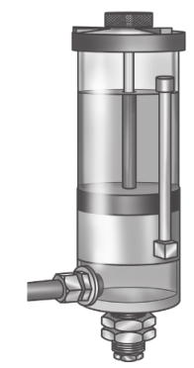
Maintaining an air compressor
Figure 8.6 Check the fluid level

Slide 11
Inspecting and replacing the air filter
Keep the air filter clean at all times.
Do not operate the compressor without an air filter.
Before using, check the air filter to ensure it is clean. If dirty, replace air filter.

Slide 12
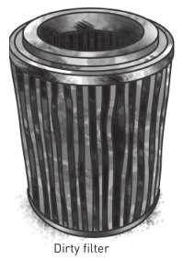
Inspecting and replacing the air filter
Figure 8.7 Air filters

Slide 13
Inspecting a belt
Check for unusual signs of belt wear and damage.
Check for cracks, frayed spots, cuts or unusual wear patterns.
Check for exposure to excessive heat.
Replace if there are obvious signs of cracking, fraying, unusual wear or loss of teeth.

Slide 14
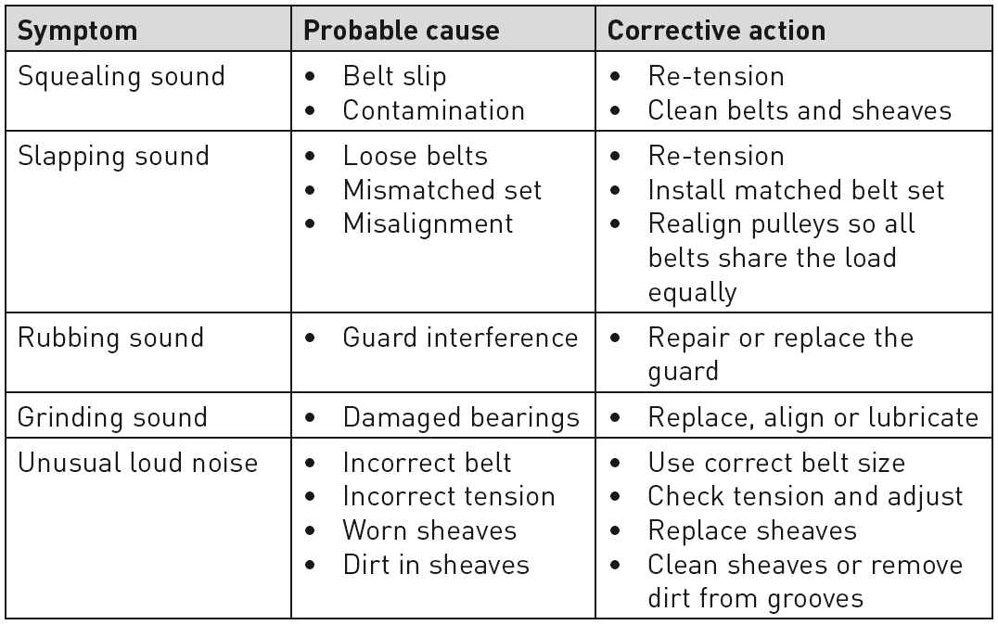
Belt noise
Table 8.2 Corrective action for different types of belt noise

Slide 15
Summative assessment
Test your knowledge of this section by completing the Summative assessment (page 127 of your Student’s Book)

